Slide 1
COLOR SPACES
OTHER THAN
RGB CMY HSV
COMPUTER VISION
AD-23402
SYED HARSHATH S
2023510045

Slide 2
INTRODUCTION
Many colour spaces exist beyond RGB, CMY, and HSV
Designed for specific applications like compression, printing, perceptual modelling

Slide 3
Why Do We Need Other Color Spaces?
Different tasks need different color representations
Separate brightness and color for compression
Perceptually uniform spaces for editing and printing

Slide 4
YPbPr
YPbPr (also written Y'PbPr) is a color space used in analog video electronics.
Similar to YCbCr but designed for analog signals, while YCbCr is for digital video.
Commonly referred to as component video in consumer electronics.

Slide 5
RELATION TO RGB
Derived from gamma-corrected RGB (R'G'B') signals.
Separates image into:
Y' (Luma / brightness)
Pb (Blue difference chroma)
Pr (Red difference chroma)

Slide 6
Mathematical Definitions
Luma (Y') equations:
HDTV: Y' = 0.2126R + 0.7152G + 0.0722B
SDTV: Y' = 0.299R + 0.587G + 0.114B
Chrominance:
Pb = 0.564(B' - Y') (SDTV)
Pr = 0.713(R' - Y') (SDTV)

Slide 7
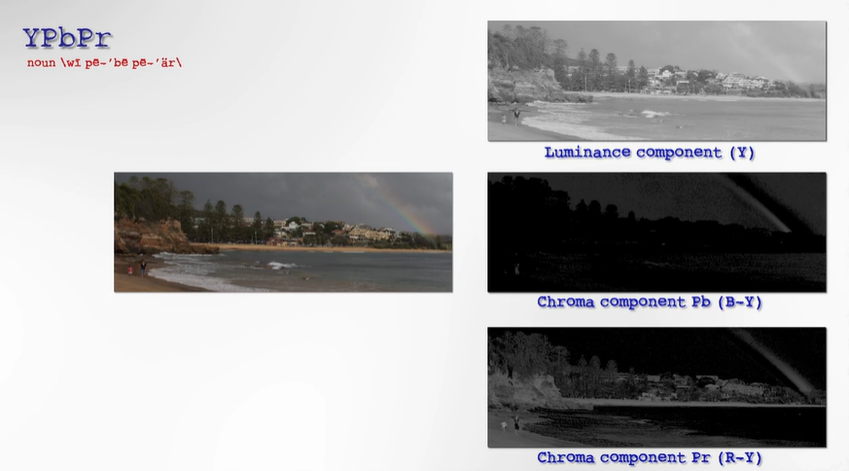

Slide 8
Signal Characteristics
Carries sync information on Y' channel (bi-level for SD, tri-level for HD).
Signals range from 0 to 700 mV (analog voltage levels).
Does not need color multiplexing → minimal color bleeding.

Slide 9
ADVANTAGES
Better image quality than composite or S-Video.
Supports higher resolutions: up to 1080p (Full HD).
Compatible with standard RCA cables (green = Y, blue = Pb, red = Pr).
PRACTICAL USAGE
Used in:
DVD players
Set-top boxes
Video game consoles
Older HDTVs

Slide 10
HSL
HSL (Hue, Saturation, Lightness) is a cylindrical-coordinate representations of RGB colors.
They rearrange RGB space to be more intuitive and perceptually relevant for humans.
Commonly used in color pickers, image editing software, and (to a lesser extent) computer vision.

Slide 11
Structure
Both models are based on a cylinder:
Hue (H): angle around the vertical axis (0° = red, 120° = green, 240° = blue, 360° wraps back to red).
Saturation (S): distance from the center axis (color purity).
Lightness (L) / Value (V): position along the vertical axis (brightness or luminance).

Slide 12
Relation to RGB
HSL and HSV are just transformations of the RGB color model.
The specific output color depends on the RGB space (e.g., sRGB, Adobe RGB) and device-specific properties like gamma correction.

Slide 13
RGB → HSL conversion formulas
Compute min, max, delta:
Cmax = max(R, G, B)
Cmin = min(R, G, B)
delta = Cmax – Cmin
Lightness (L):
L = (Cmax + Cmin) / 2

Slide 14
Saturation (S):
if delta == 0: S = 0 else: S = delta / (1 - abs(2*L - 1))
Hue (H):
if delta == 0: H = 0
elif Cmax == R: H = 60 * (((G - B) / delta) % 6)
elif Cmax == G: H = 60 * (((B - R) / delta) + 2)
elif Cmax == B: H = 60 * (((R - G) / delta) + 4)

Slide 15
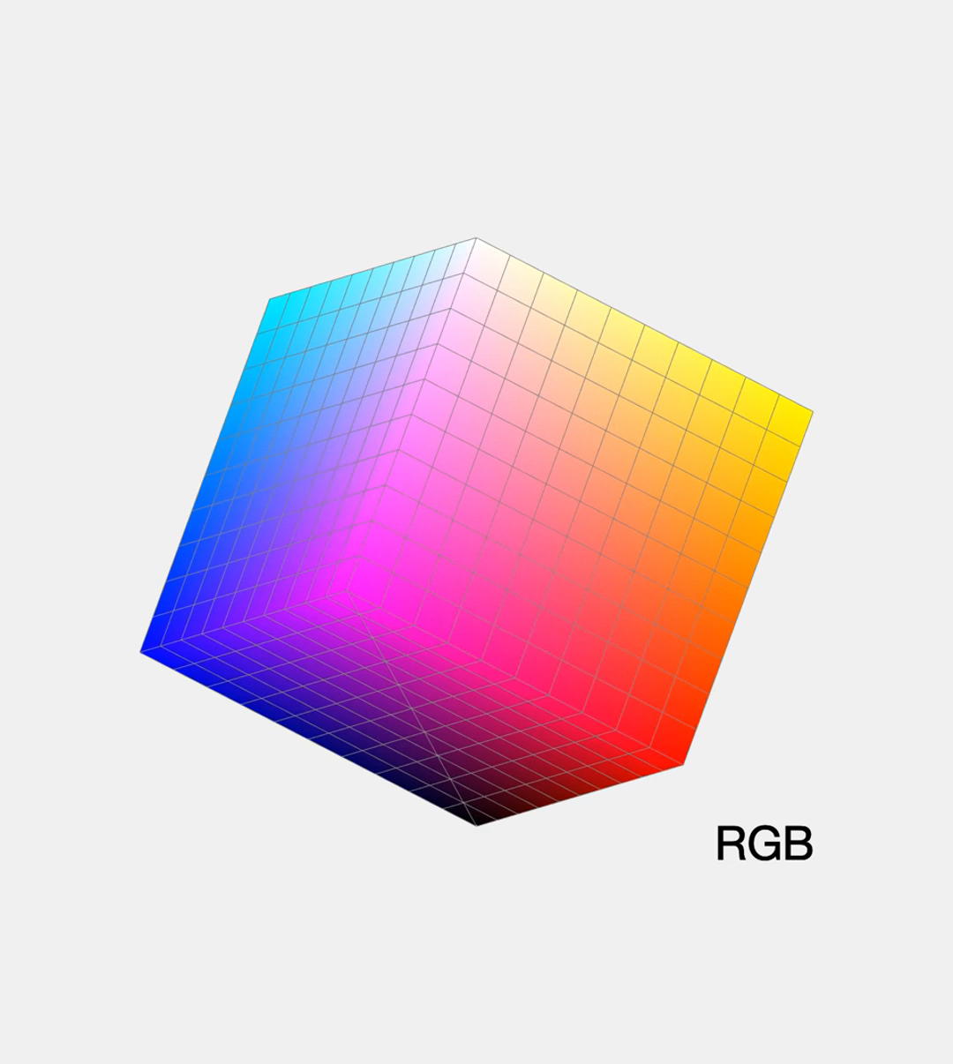
RGB TO HSL

Slide 16
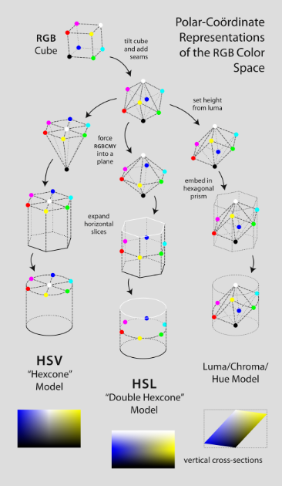
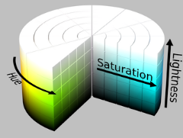
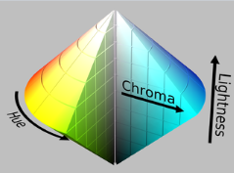
HUE SATURATION LIGHTNESS

Slide 17
Motivation
RGB is device-centric and unintuitive for tasks like adjusting brightness or mixing tints/shades.
HSL/HSV provide models closer to traditional art concepts (e.g., tints, shades, tones).
Their simple math made them practical for 1970s computers.

Slide 18
LIMITATIONS
Not perceptually uniform: small changes in HSL/HSV don’t correspond to equally perceived color differences.
Models like CIELAB or CIECAM02 are better at representing perceptual differences but are more computationally complex.

Slide 19
Aspect | HSV (Hue, Saturation, Value) | HSL (Hue, Saturation, Lightness)
Brightness axis | Measures brightness (value) from black (0) to full color (1) | Measures lightness from black (0), through pure color (0.5), to white (1)
Full saturation level | Full saturation colors are always at V=1 (top of cone) | Full saturation colors are at L=0.5 (middle of bicone)
Saturation meaning | Measures how much black is mixed with the color | Measures how much gray is mixed with the color
Model shape | Hexcone (cone) | Bi-hexcone (double cone or diamond shape)
White mixing behavior | Adding white reduces value but keeps saturation constant | Adding white reduces saturation

Slide 20
YIQ Color Space
YIQ is the color space used by the NTSC analog TV system
(mainly in North America and Japan).
It separates an image into:
Y (Luma): brightness (black-and-white image)
I (In-phase): orange-blue chrominance
Q (Quadrature): purple-green chrominance
Black-and-white TVs only decode Y → backward compatibility.

Slide 21
Why YIQ?
Human eyes are more sensitive to orange-blue (I) than purple-green (Q). Therefore: I gets higher bandwidth (1.3 MHz) Q gets lower bandwidth (0.4 MHz) Designed to optimize bandwidth while preserving perceptual quality.

Slide 22
YIQ vs Other Color Spaces
COLOR SYSTEM | COLOR SPACE
NTSC | YIQ
PAL | YUV
SECAM | YDbDr
Digital TV | YCbCr

Slide 23
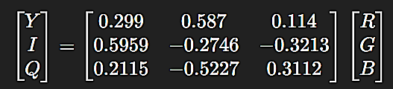
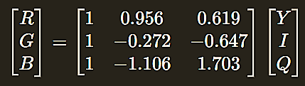
Conversion Equations
RGB to YIQ:
YIQ to RGB:

Slide 24
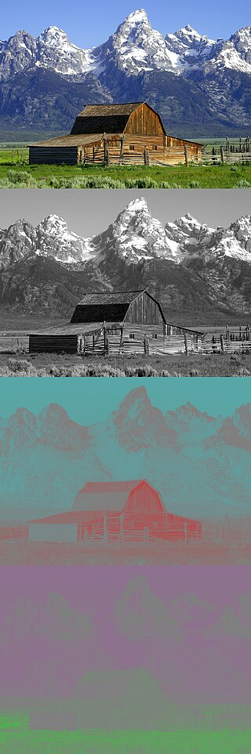
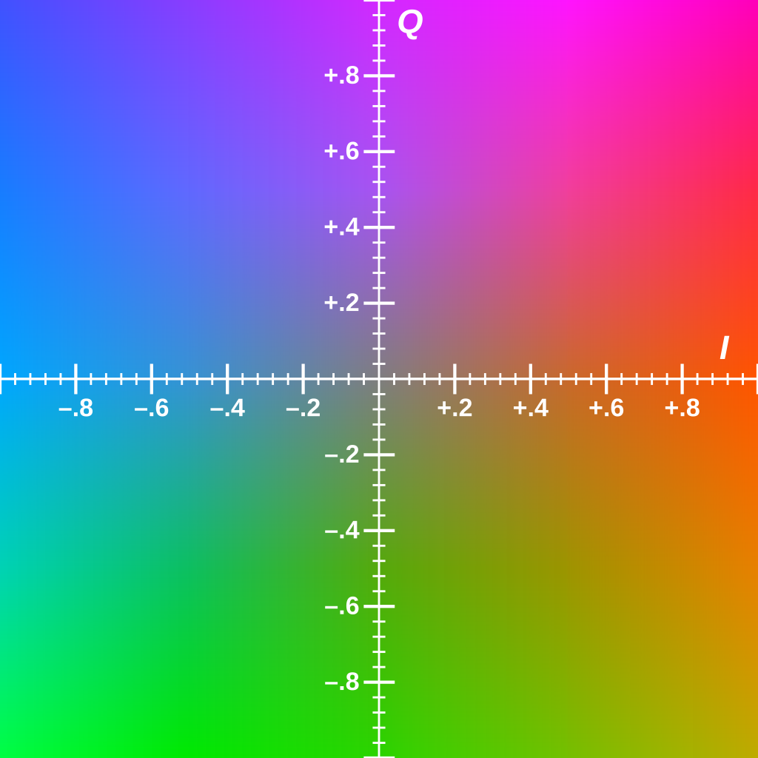
YIQ COLOR MODEL

Slide 25
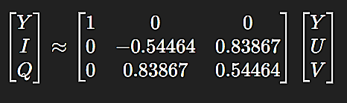
YIQ ↔️ YUV Relationship
YIQ is a rotation of YUV by 33° in UV plane:
Both share same luma axis; differ in chrominance axis.

Slide 26
Practical Usage
Rarely implemented in modern TVs → simpler R-Y / B-Y decoders were cheaper.
Some high-end TVs (e.g., RCA Colortrak, Advent) used full I/Q decoding for better color fidelity.

Slide 27
CONCLUSION
In this presentation, we explored different color spaces such as YPbPr, HSL, and YIQ, understanding their structures, mathematical conversions, and real-world applications.
YPbPr represents color with luminance and chrominance components, they are used in analog and digital systems respectively.
Color spaces like HSL and YIQ offer intuitive or broadcast-friendly ways to represent colors for specific tasks.

